Slide 1
DATA SCIENCE INTERNSHIP APPLICATION PROGRAMMING
Data Science on Subscription Service – DATALAB FINAL PROJECT
IFEYINWA VICTORIA NWOBODO
TEAM ACHIEVERS 2023.
Github link: https://github.com/vezeukwu/Subscription_Service_Analysis_Forecast_Project.git

Slide 2
Data Science on Subscription Service – DATALAB FINAL PROJECT
This project involves cleaning and processing of data from a book subscription platform -livebook (the given actions2load dataset), and preparing it for investigatory analysis to discover customer use patterns. Raw data of customer behaviour was loaded into an SQL database for analysis, the events record were categorized and checked for bad data, insights were generated that helped to understand various metrics and forecast next events possible. Find below the processes and outputs.
The MySQL Part
The given Dataset was loaded into the MySQL Workbench with the aim of determining :
What events were the most and the least common.
The account ids with the most and least number of events.
The number of times events occurred at different times of the day.
From the analysis performed; The most common event is ReadingOwnedBook with a count of 24628 while the least common event is UnknownOriginLivebookLinkOpened with a count of 1. The Account id with the highest number of event is caffe2b03e6057845c52212acaaa1a34 with a count of 1574, while there are more account ids with least number of events count as 1. This detail is captured in the MySQL script.
The screenshots of MySQL Workbench with the different analysis stated above are found in subsequent slides.

Slide 3
Exploratory data analysis
This python part of the project seeks to examine
If events happen equally at different times of the day, and how a person uses the service at different times of the day.
If there are missing data and outliers in the given dataset and fixing them.
We’ll find screenshots of python analysis in subsequent slides.
The given data read into the Jupyter notebook, were numerically encoded and analyzed with the following results:
The time intervals between event types are relatively consistent as shown in the screenshots. This suggests that events are occurring equally at different times because the mean and median are not significantly different.
Account_id: '89f7601cb558e1c47b00a7fabb6a466c’ was analysed to show how this person uses the services at different times of the day, it was observed that the only event type he engaged was ReadingOwnedBook.
There are no missing data in the events record
The difference between the 75% and max percentile is not so high, so its not confirming the presence of outliers hence we can say there are no potential outliers in the dataset.

Slide 4
THE POWER BI PART
This aspect of the project seeks to build an algorithm that can forecast the next event time - when customers are likely to engage with the service. This is achieved using PowerBi dashboard to forecast event counts using different hours of the day for 24hours. The data for this forecast was extracted from the MySQL event counts and time analysis.
The line graph was used as my visualization tool because it best showcases how data changes over a period of time- in this case 24hours, which makes it easier to identify trends and pattern.
Find Screenshots below which shows the raw data – its count and time, the data at 95% confidence interval, I used the 95% confidence interval just so it can accommodate wide range and even the extreme values.
This PoweBi dashboard forecasts the events for 24hours ignoring the last 5hours; this compares the forecasting result with the actual data. The blue lines represents the actual data, the gold lines represents the forecast data while the solid gold fill on the forecast represents the confidence interval.

Slide 5
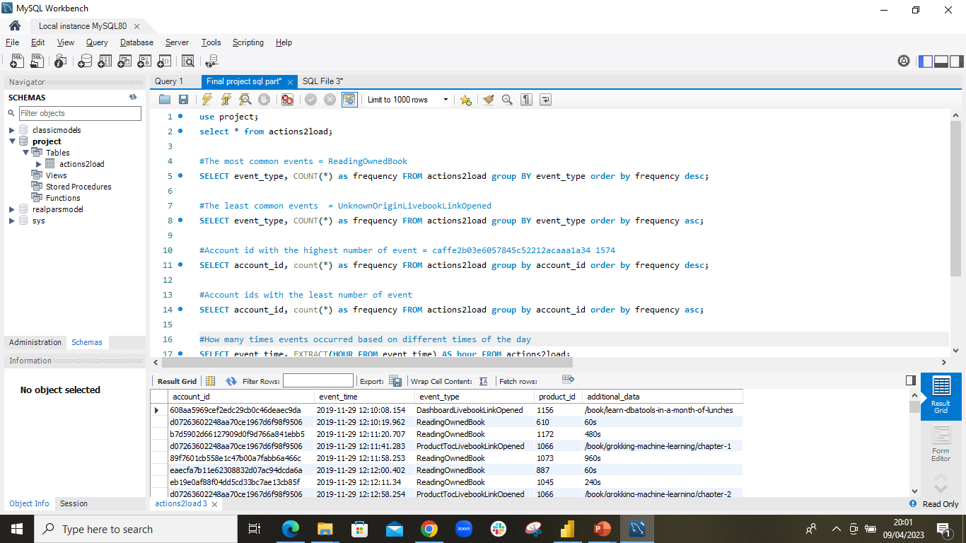
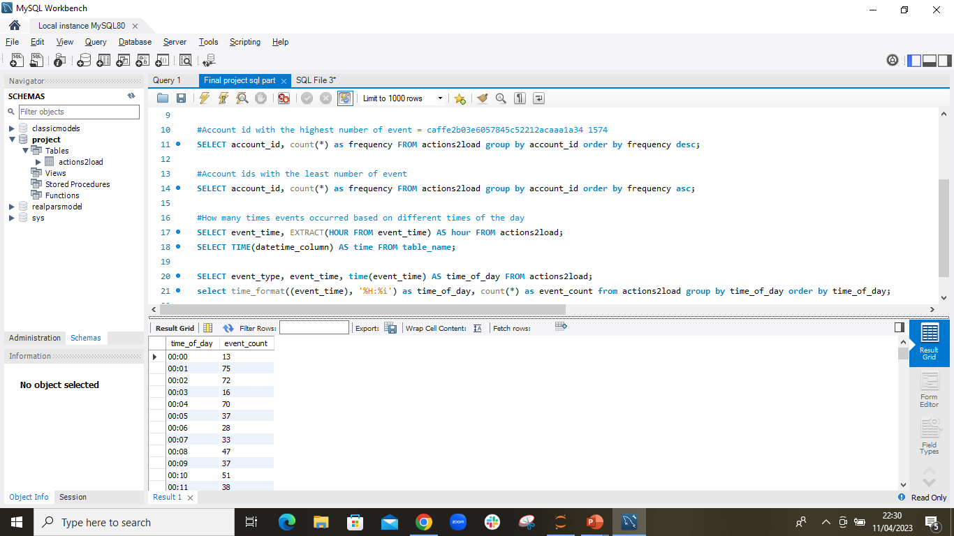
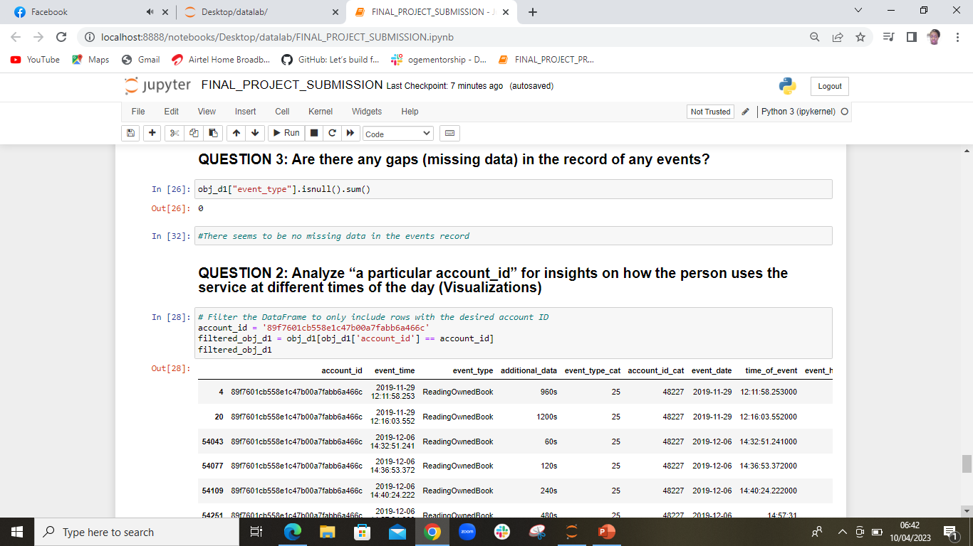
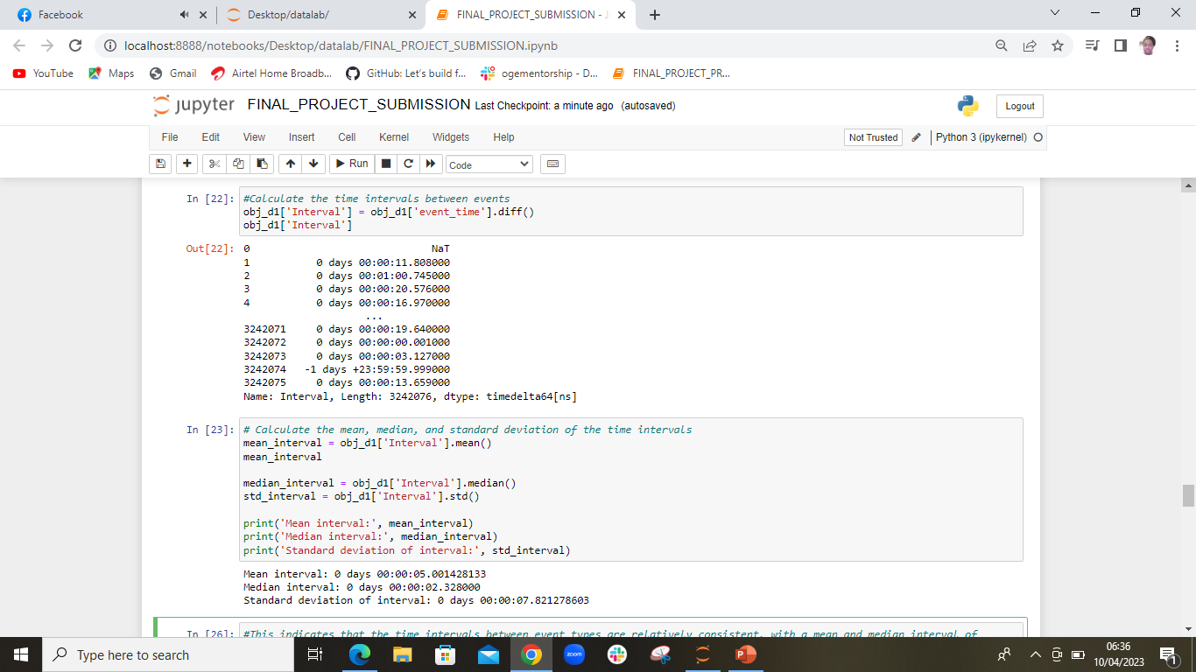
PROJECT SCREENSHOTS

Slide 6
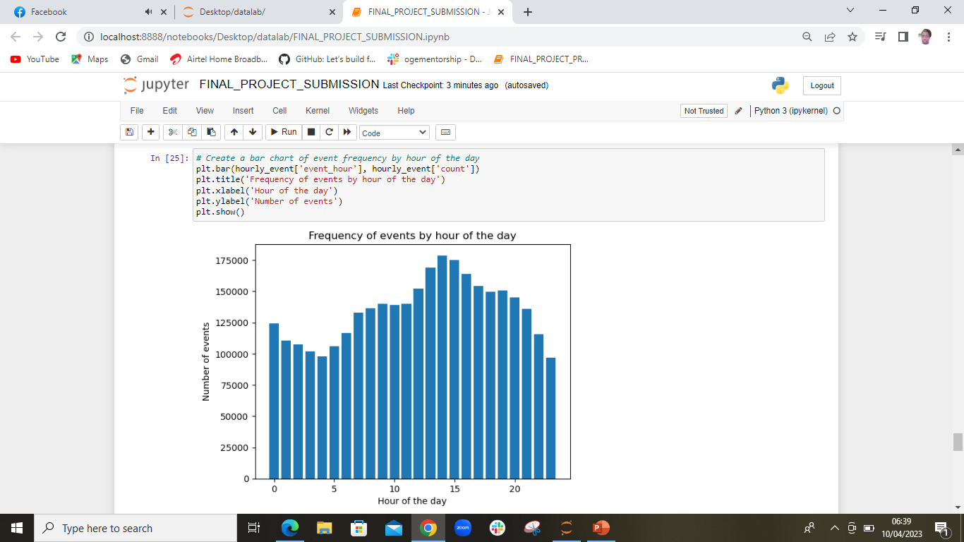
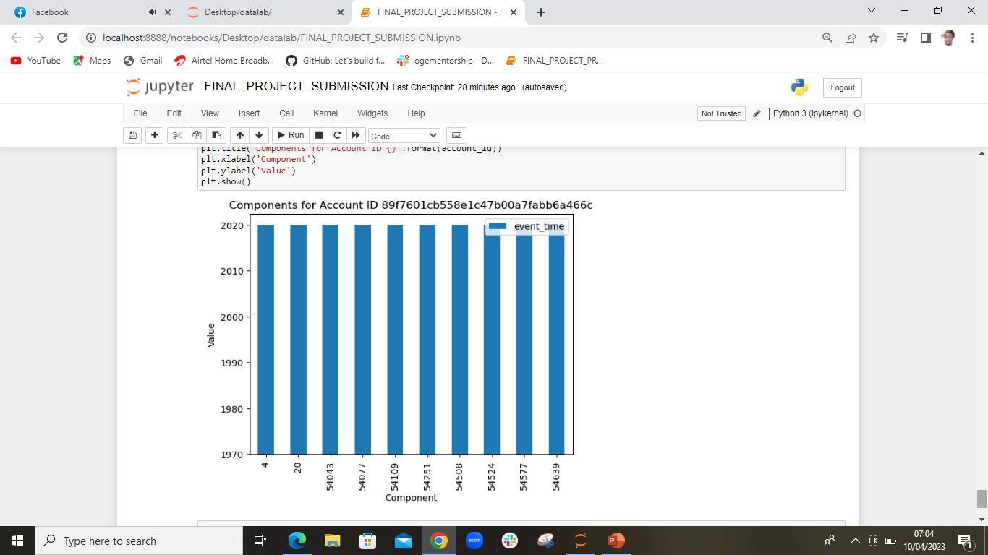
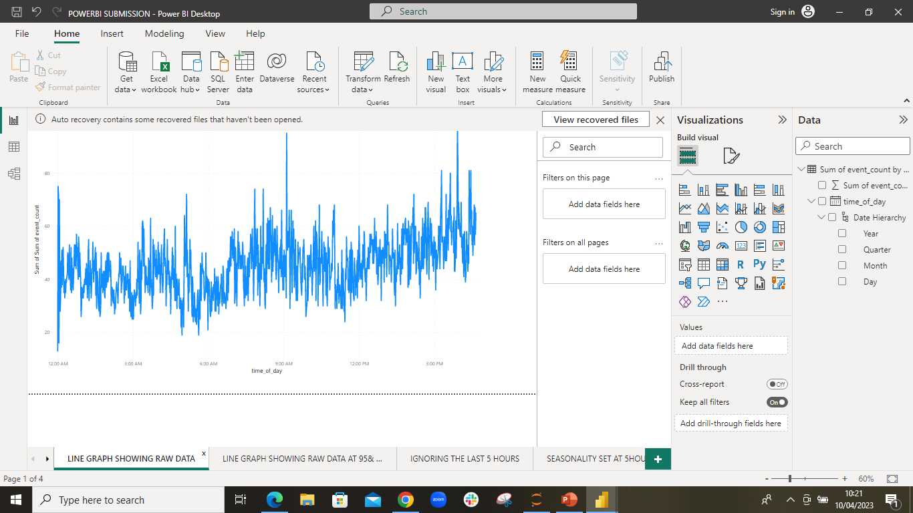
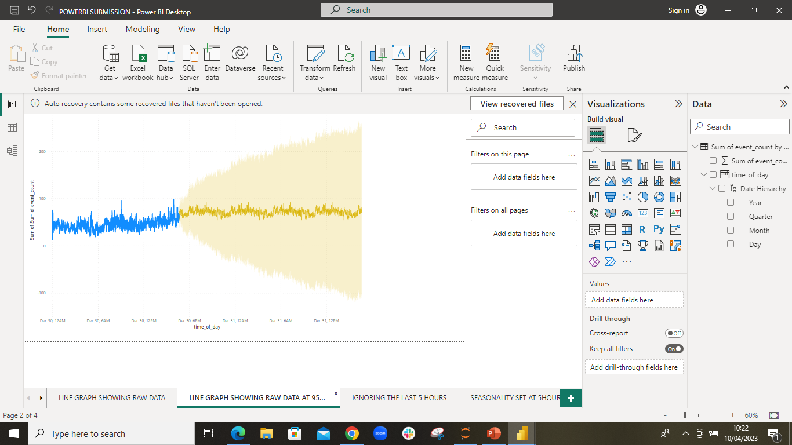
PROJECT SCREENSHOTS

Slide 7
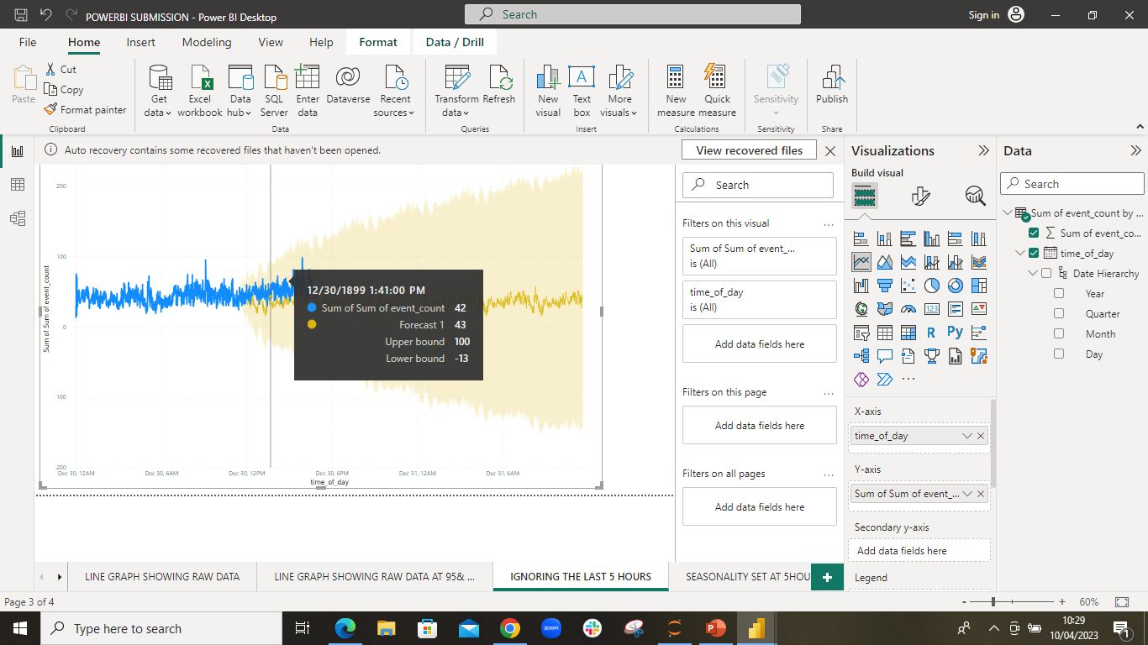
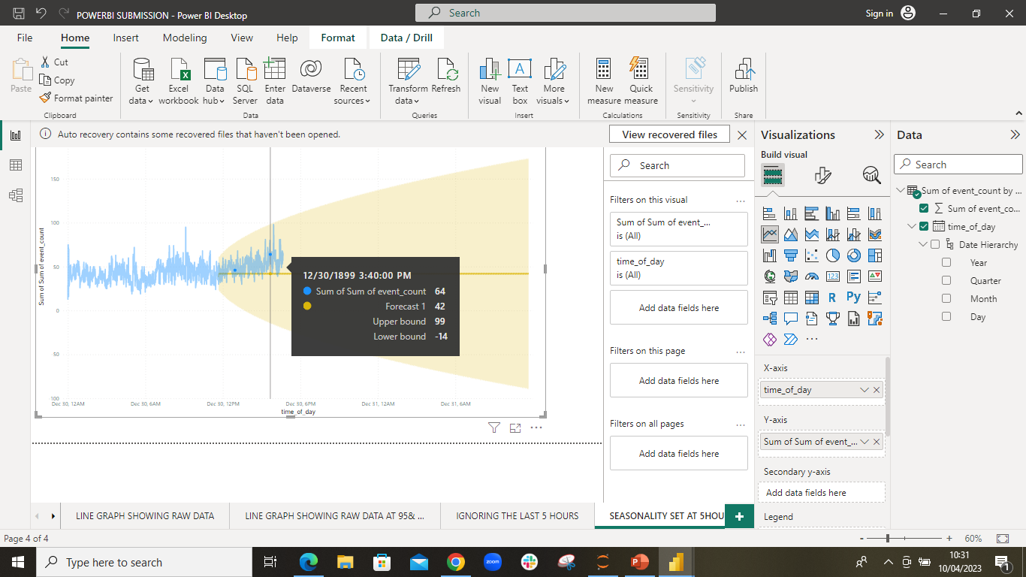
Project SCREENSHOTS
THANK YOU

